Slide 1





Project CARBOTRAF
A Decision Support System for Reducing CO₂ and Black Carbon Emissions by Adaptive Traffic Management
Martin Litzenberger, Project Coordinator, AIT Austrian Institute of Technology

Slide 2
Project Idea and Innovation
Idea
  CO₂ and back carbon (BC) reduction by smart traffic management
  Pilot operation in Graz and Glasgow
Innovation
  Linking of CO₂ - aspects and ITS measures (focus not on reduction of congestion but rather “CO₂-reduced“ traffic)
  BC is the second most important greenhouse factor and is also dealt with in the project
  ITS aspect: Not only traffic development prediction but also decision support for ITS counter measures
Goals
  Development of methods and tools to reduce emission of CO₂ und BC by e.g. re-routing traffic
  Evaluation of the concept in two pilot installations/test operations

Slide 3
Decision Support System (DSS)
step 1: real time monitoring of traffic situation
Traffic monitors (existing devices and additionally installed by the project) measure speed, volume and composition of vehicles and detect emission relevant traffic states (e.g. stop/start situation). Air quality is also monitored.
step 2: prediction of traffic situation 30-60 mins. into the future
step 3: computing CO₂ & BC emissions (current and prediction) from traffic
step 4: an improved traffic scenario is selected that is able to satisfy the traffic demand at reduced total CO₂ & BC emissions (and improves further defined key performance indicators)
step 5: ITS action options are displayed to the traffic centre operator who finally deceides on their implemetation („human in the loop“)

Slide 4
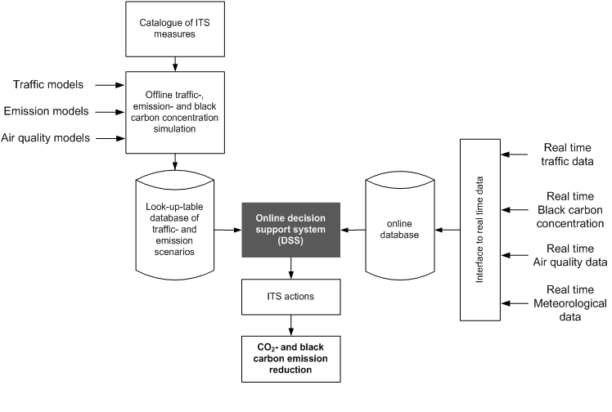
Technical Concept

Slide 5
Project Facts
EC collaborative research project in the 7th framework program:
  submitted January 2011
  project started Sept. 1st 2011
  planned project end Aug. 31st 2014
Project Coordination: AIT Austrian Institute of Technology GmbH
Project Partners: 8 organzations from 4 different countries (Austria, Belgium, UK, Ireland)
Budget: € 4,4 Mio. ( € 3,0 Mill. EC funding)
Pilot cities: Graz & Glasgow
www.carbotraf.eu

Slide 6
Project partners and their roles in the project
AIT Austrian Institute of Technology GmbH
coordination, air quality monitoring Graz, traffic monitoring technology provider
Österr. Forschungs- und Prüfzentrum Arsenal GmbH, Austria
requirements analysis, traffic simulation and ITS actions selection
IBM Österreichische Büromaschinengesellschaft mbH with
IBM Research Irland (as "third party")
Decision Support System (situation prediction and ITS actions proposal)
EBE Solutions GmbH, Austria
User Interface for traffic centres, installation of equiptment in Graz, hosting of DSS
Imperial College London, UK
traffic simulation, emission models
VITO, Belgium
Emission models, planning of pilot installations, evaluation of results
Air Monitors Ltd., UK
installation of equiptment in Glasgow, air quality monitoring Glasgow
European Tech. Serv., Belgium
Dissemination and exploitation of project results

Slide 7
Pilot installations and operations in Graz and Glasgow
The test cities will benefit from the pilot installation without further costs (within the possibilities given by the project budget)!
Freedom of action to satisfy requirements and proposals from city authorities
Benefits for the test cities
  The stakeholders are able to influence project priorities by bringing in their view on most urgent needs (key performance indicators)
  Access to online data from additional traffic and black carbon monitoring devices during pilot operation
  At the end of the pilot operation: basis for the decision on implementing ITS actions from the analysis of the test operation is available, covering the aspects of CO₂ & BC emissions reduction, as well as traffic and air quality

Slide 8
CARBOTRAF
A Decision Support System for Reducing CO₂ and Black Carbon Emissions by Adaptive Traffic Management

