Slide 1
Workshop related projects
ICT2011: 6.6 Low carbon multi-modal mobility and freight transport
Vienna, October 24th 2012

Slide 2
Agenda
10h30-12h00
Welcome, introduction of participants
Workshop goals & objectives
Presentation of individual projects
12h00-13h30 Lunch Break
13h30-15h00
Project presentations continued
Discussion & group work on selected topics (e.g. user requirements, usability, persuasion, platform architectures, etc. )
15h00-15h30 Coffe Breack
Conclusions & next steps: identification of open research issues, possibilities for cooperation, planning of next steps)
17h00 End

Slide 3
Goals of this workshop
Learn about other projects
Share experiences
Learn from each other
Identify key issues
Identify possibilities for cooperation
Have fun!
Organize common publication

Slide 4
Introduction of participants
Name
Organization
Project
Background
How did you get here?
Which tools did you use for planning the trip?
Which transportation means did you use?
What positiv/negativ experiences did you make?

Slide 5
Who is here?
Technical versus social sciences
Work experience
Project runtime
Most used personal transportation means
Who knows who

Slide 6

Peacox project presentation

Slide 7

Partners
CURE - Center for Usability Research and Engineering - Coordinator (A)
FLU - FLUIDTIME Data Services GmbH (A)
TMX - Telematix Software a.s. (CZ)
ETHZ – Swiss Federal Institute of Technology Zurich (CH)
TCD – Trinity College Dublin (IRL)
ICCS – National Technical University of Athens (GR)
ITS- ITS Vienna Region (A)
TOMTOM INTERNATIONAL BV (NL)
Total Costs: 3,131,155.00
Requested Funding: 2,350,000.00

Slide 8
Project Goals
The project aims at
providing travellers with personalised tools that allow, help and persuade them to plan their travel in an environmentally friendly way
supporting the users in making eco-friendly travel decisions and give them feedback
considering the users situational and individual range of acceptable travel choices
facilitating eco-friendly driving behaviour by providing real-time feedback and instructions about driving
reducing of the carbon footprint without reducing quality of life and comfort for travellers

Slide 9
4. PEACOX offers
Mobile smart phone application
Eco-friendly route planning and navigation
Eco-friendly travel suggestions with comfort
CO2 feedback for selected routes and means
Detection of individual travel patterns
Personalised and green travel suggestions
Real time traffic information service
(e. g. weather, traffic situation)

Slide 10
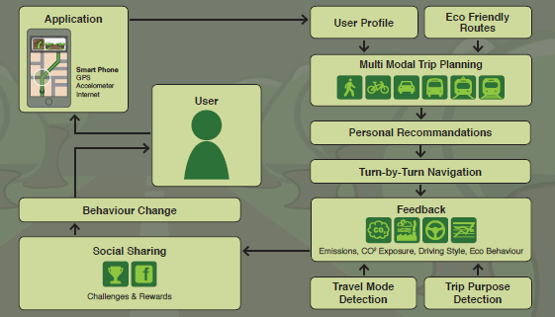
5. PEACOX Components

Slide 11
Available Results (as of now)
Identification of user groups
Analysis of concepts that explain mobility behavior
Description of context and situational variables
Questionnaire study on factors influencing travel mode choice
Collection and analysis of persuasive strategies
User interface design concept

Slide 12
Peacox App Overview (1/2)
Travel
Route planner
Personalised routing results
Departure monitor
Turn-by-turn navigation
Live
Real time eco feedback (incl. driving behaviour)
Current travel mode
Current trip purpose
Activity
Trip history, comparison between days/weeks/months/years
Me
User profile
Travel preferences
Goals commited to
Achievements
Goal recommendations

Slide 13
Peacox App Overview (2/2)
Travel
Route planner
Live
Real time eco feedback (incl. driving behaviour)
Activity
Me
User profile
Departure monitor
Current travel mode
Current trip purpose
Turn-by-turn navigation
Personalised routing results
Achievements
Goal recommendations
Trip history, comparison between days/weeks/months/years
Goals commited to
Travel preferences
Authority / Self-Monitoring
Suggestion / Tunnelling
Consistency / Social Proof
Authority / Self-Monitoring
Conditioning
Suggestion

Slide 14
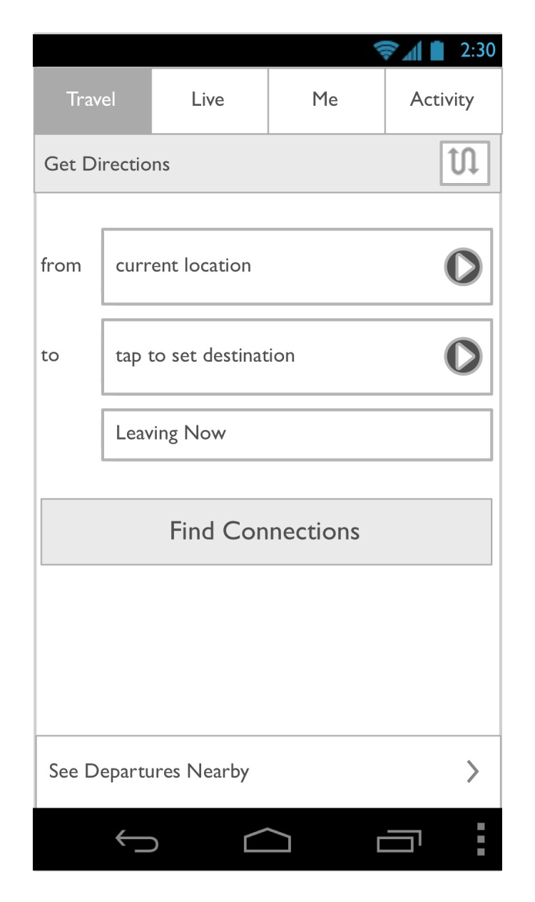
Peacox App Walkthrough Travel Planner (1/3)
Notes:
Travel planner: simple UI to help the user to find route alternatives to get from a to b

Slide 15
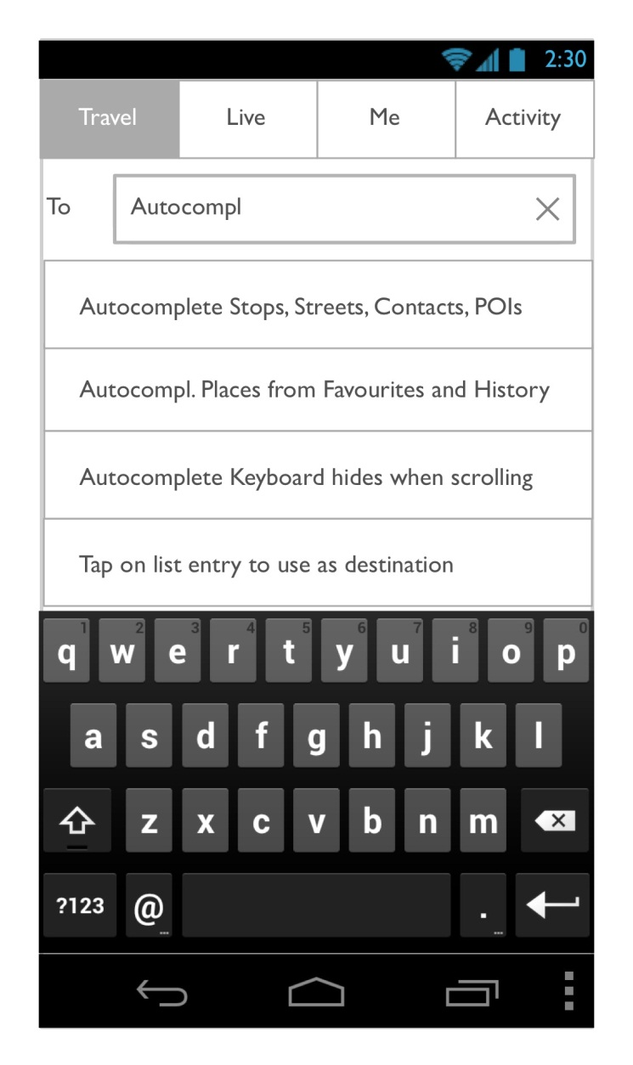
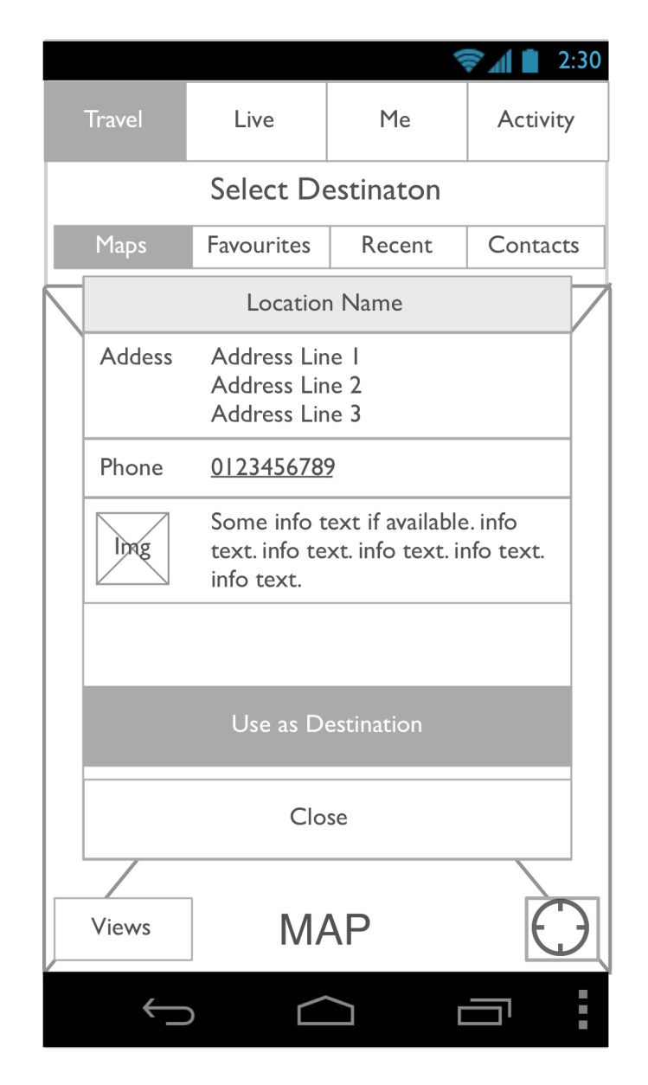
Peacox App Walkthrough Travel Planner (2/3)
Notes:
Allows search or picking a location from a list or map

Slide 16
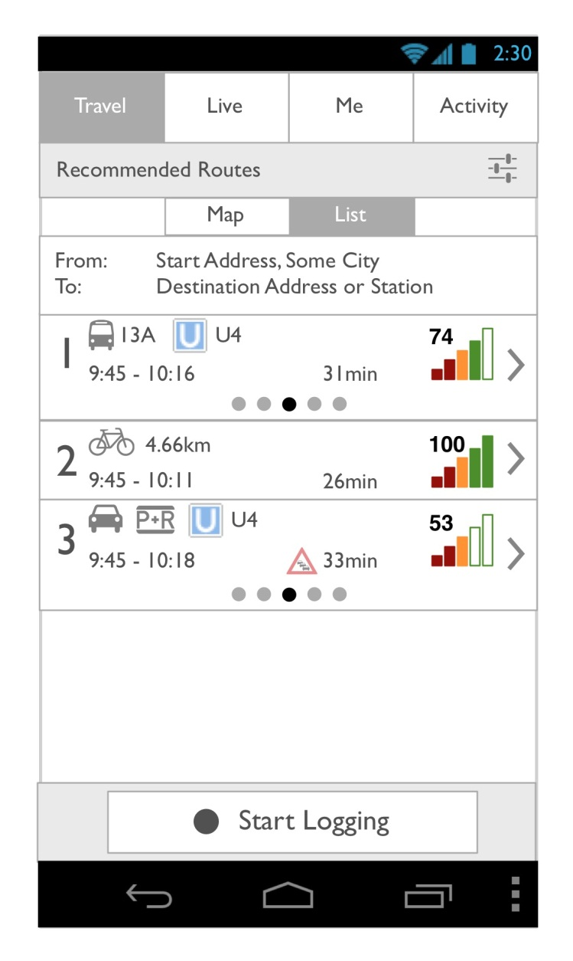
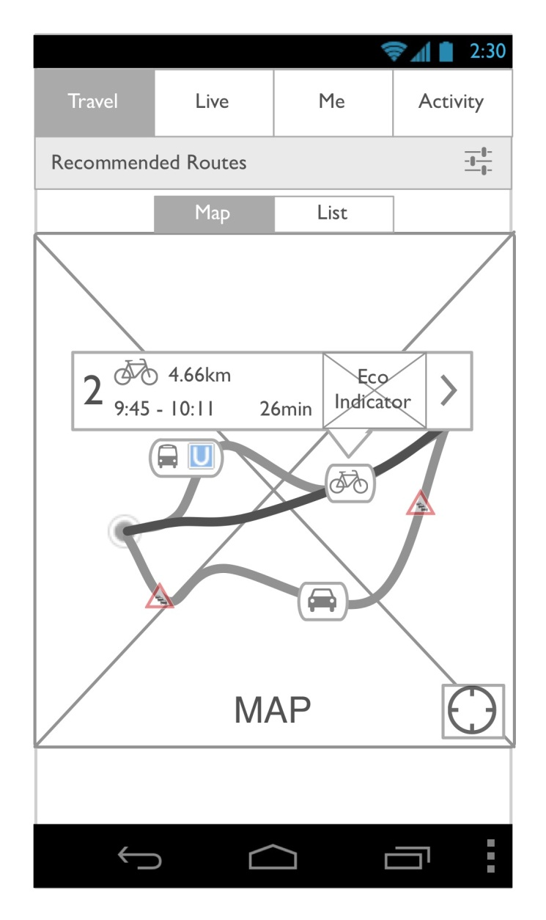
Peacox App Walkthrough Travel Planner (3/3)
Notes:
Route finding: result lists listes personalised routes – tailored and balanced between user preferences and eco-friendliness of route option
View as list or as map
Indicator for eco-friendliness is only indicative – will most likely change
→ goal: information BEFORE a user makes a trip choice

Slide 17
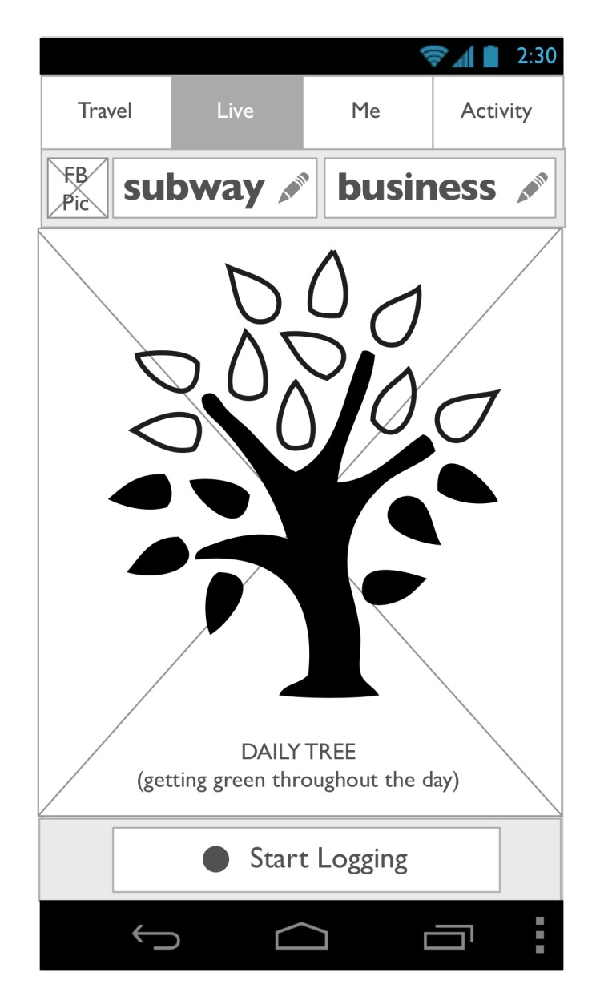
Peacox App Walkthrough Live Feedback
Notes:
Quick high-level feedback on current travel behaviour.
(also includes automatic travel mode and trip purpose detection)
→ goal: information WHILE user is travelling

Slide 18
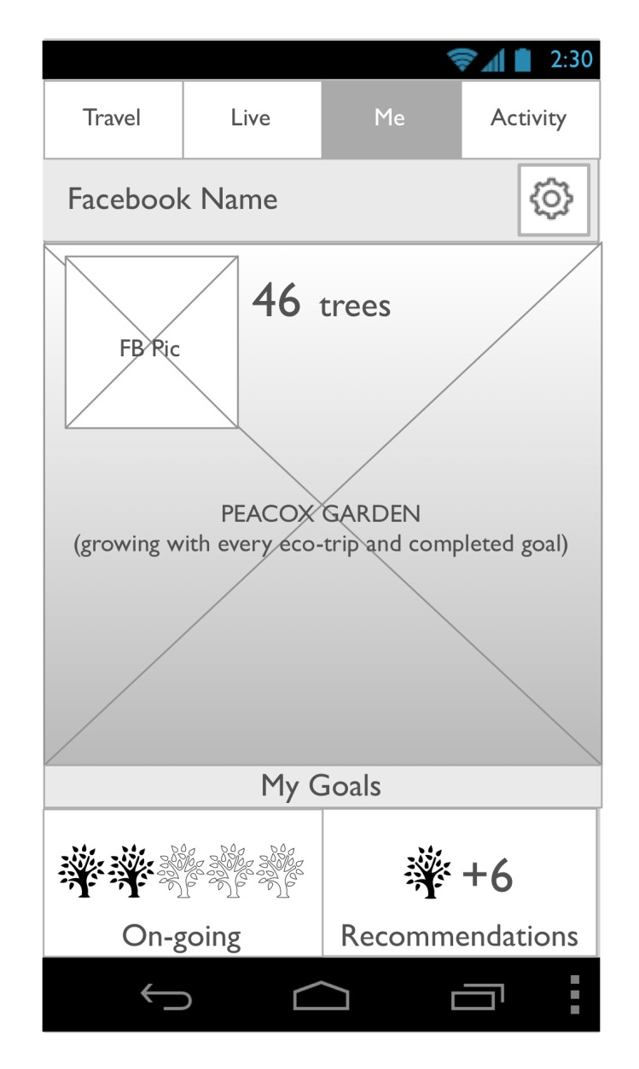
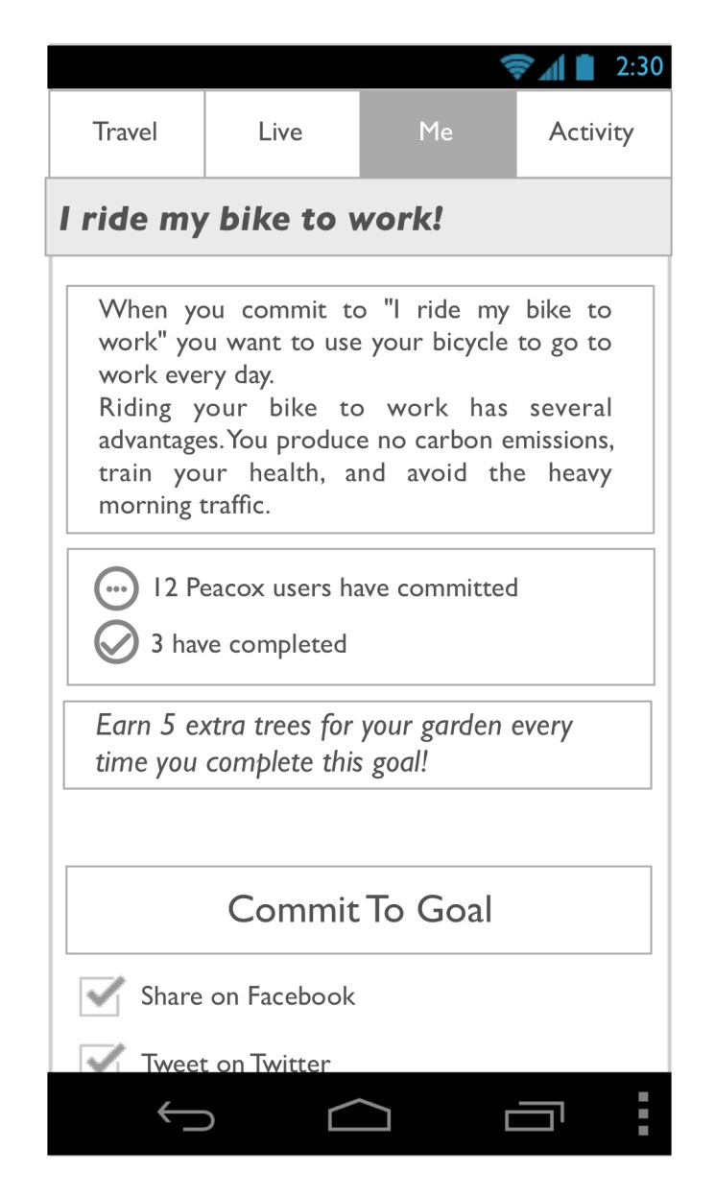
Peacox App Walkthrough Me (Profile) & Goals
Notes:
Me (=user profile): shows long-term achievements and let‘s user commit to goals
Social aspects – commitments and achievements can be shared on Facebook

Slide 19
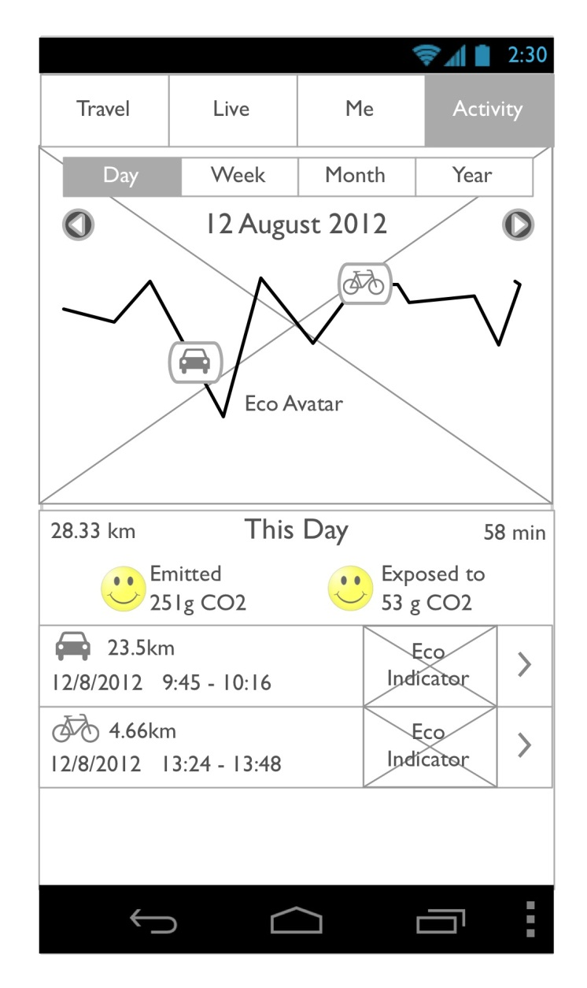
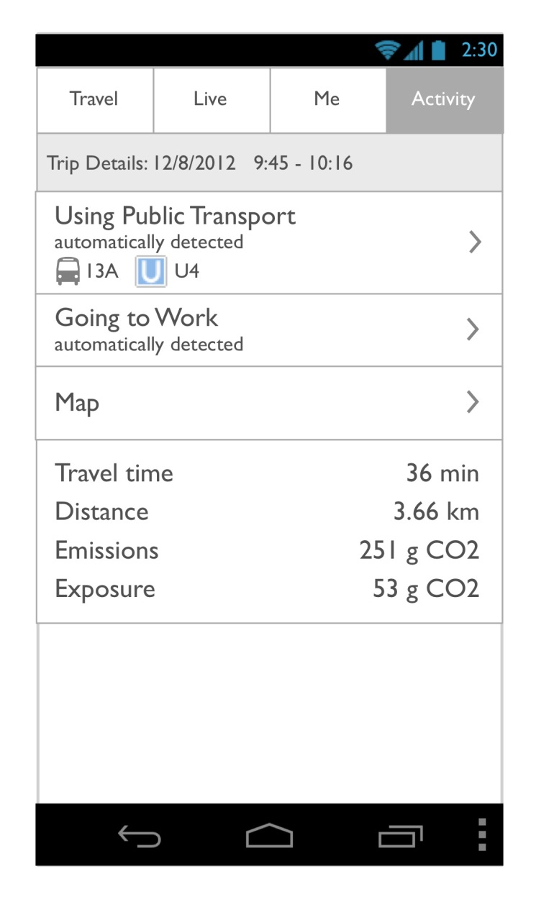
Peacox App Walkthrough Activity Log
Notes:
Detailed long-time feedback on travel history.
Both high-level aggregated feedback (curve can be set to Day/Week/Month/Year view)
And individual trip details
→ goal: information AFTER a trip

Slide 21
Planned Book Publikation
Topic: The role of users in intelligent transportation systems: possibilities, challenges and lessons learned
Who is interested in submitting chapters?
On which topic/aspects?
Who is interested in joining editorial work?
We propose a process of mutual peer reviewing

